Slide 1
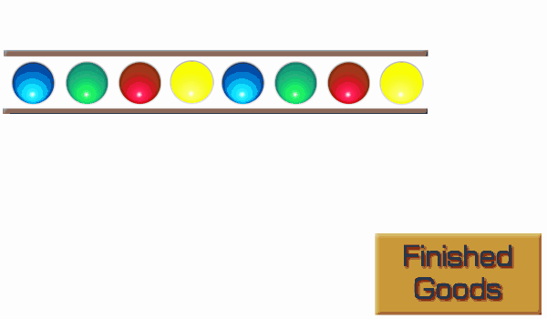
Takt Time
What happens if the product takes 32 seconds to make?
You need to set the process up with a number of separate work stations.
A maximum of 4 seconds of work is done at each station and then the product is passed on.
Notes:
To meet customer demand a finished product is required every 4 seconds. But it takes 32 seconds to make
Press to reveal the next 2 statements.
Press to reveal moving image. Note it stops and reruns after every 8 moves.

